Slide 1
Theme Park Multiplication – Creating Communities of Mathematical Inquiry
Susie Groves
Deakin University
susie.groves@deakin.edu.au

Slide 2
Japanese structured problem-solving lessons
,
Presenting the problem for the day (5 – 10 mins)
Individual (or group) problem solving (10 – 15 mins)
Whole class discussion of student solution strategies (10 – 20 mins)
Summing up by the teacher (5 mins)
(Shimizu 1999)
The lesson plan – Flow of the lesson
Understanding the task (10 mins)
Independent problem solving (10 mins)
Discussion (35 mins)
Individual reflection (5 mins)

Slide 3
Careful choice of the task
The choice of numbers – $43 x 6 (Trudi – planning team)
We changed our numbers – we had ‘something’ times 7 but it wouldn’t provide opportunity to
do what Ari did ‘I know my 3 times. I can split it and work it out that way’
or ‘I know my 2 times and I can split it that way’ (although no-one did this)
T: What made it trickier [than previous tasks]?
Mo: Bigger numbers ... like 43
Lex: … and because it had more groups than we’re used to
T: Yeah, we were ‘timesing’ by 6 … we haven’t done any problems where we were ‘timesing’ by 6, have we?
Es: Last time … it was an even number, and the even numbers is what we use to [skip] count to multiply and the number … is an odd number
Lu: … an odd number is harder
Jorja: I’ve got something to add onto Lulu’s. Because it’s not like when you ‘carry by’ five’s, it would go to a zero. It goes 3, 6, 9, 12. Like, there is no stopping at 10

Slide 4
Creating a classroom community of mathematical inquiry

Slide 5
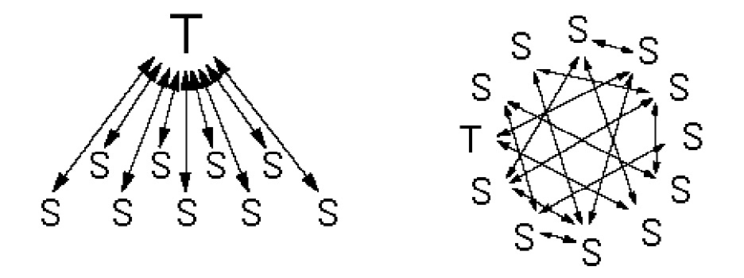
Patterns of classroom interaction
Initiate-Response-Evaluate (IRE) vs Community of Inquiry
Splitter 1998 Nathan & Knuth 2003

Slide 6
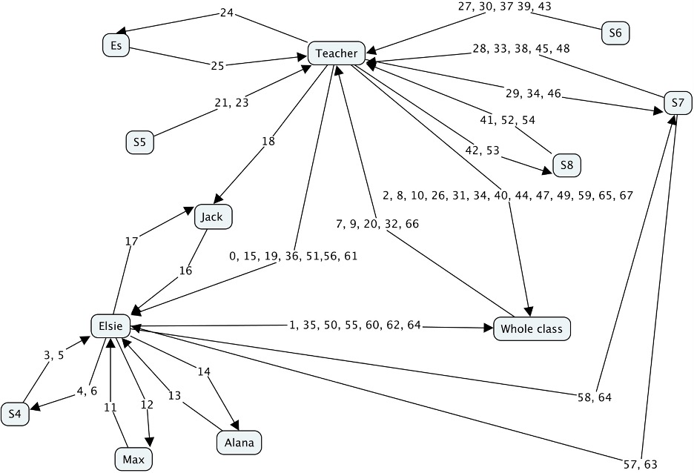
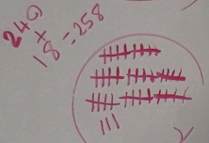
Elise’s solution – 6 minutes of discussion

Slide 7
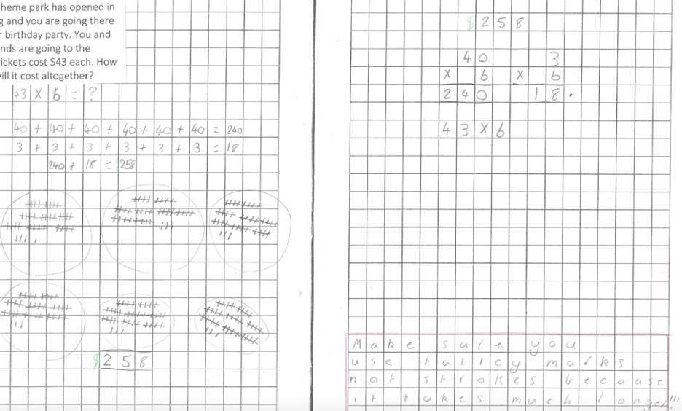
Elise’s worksheet

Slide 8
Some early comments
1. Elise: So, my strategy was “groups of”... and I did six groups.
2. T: So people on the floor, if you’ve got questions, or if you want to ask anything, or comment, you can make them, but...
3. S4: Elise, why did you do “groups of”?
4. Elise: Because it was just one of the strategies that I selected. Yeah, that’s why I did it.
5. S4: But it’s not the most efficient.
6. Elise: I know it’s not, but I just wanted to keep it straight forward.
…
16. Jack: Elise, why didn’t you do just one group and times it by six, because it would’ve been much quicker than this way?
17. Elise: Well, I didn’t think to do that, so….
18. T: It might be difficult for some people to do that, too, Jack. Sometimes people need to see something visually, and be able to use that and count out things …

Slide 9
The discussion
Trudi: it was brave for the kids asking questions without you prompting them.
Felicity: I’ve got a couple of kids in there who, that comes naturally to them … they’re like that with everything … and that sort of… models it and sort of encourages other kids to start asking questions.
The school’s research theme
To promote students’ ability to think independently, articulate their thinking and utilise the thinking of others while focusing on problem solving in mathematics.
Long-term goal for the school
Takes a long time to establish the socio-mathematical norms (Cobb, Wood & Yackel, 1991)
,

Slide 10
Socio-mathematical norms
E.g. normative (shared) understandings of what counts as
mathematically different, sophisticated, efficient, elegant
an acceptable mathematical explanation or justification
Social norms vs Socio-mathematical norms
students should offer different solutions – a social norm
what constitutes a different solution – a socio-mathematical norm
Socio-mathematical norms are interactively constituted
e.g. no criteria as to what constitutes a different solution
negotiated by the teacher & students through interactions
teacher represents discipline of mathematics
teacher‘s reaction to a solution indicates how it is valued mathematically
Yackel & Cobb 1996

Slide 11
Lesson conclusion
,
Great student reflections
Sharing with partners
Ari: People should use other multiplication questions to work out the answer
But … A good discussion occurs … when the net result … is discerned as marking a definite progress as contrasted with the conditions that existed when the episode began. (Lipman, Sharp & Oscanyan, 1980, p. 111)
Goal of the lesson
To develop and extend the use of efficient strategies to solve 1-digit by 2-digit multiplication problems.
Not specific to the lesson
Difficult with composite class, but maybe as Keiko Hino said connecting different strategies – e.g. Elise’s “groups of” with “split strategies”
Or Ari’s ‘using what you already know to solve harder problems’

Slide 12
Lesson study & professional learning in communities of inquiry
,
Importance of the research theme
Genuine long-term, whole-school mathematical inquiry
Not just about collaborative planning of a lesson
Role of the post-lesson discussion
Not just important for the teacher & the planning team
professional learning for all observers (including tonight)
Progressive classroom discourse (Bereiter 1994)
generating new (local) understandings
working towards common understandings
can be like scientific discourse
Role of the knowledgeable other

Slide 13
Thank you Felicity, the planning team and the Grade 3 & 4 children for such a wonderful lesson

