Slide 1
A comment from the perspective of structured problem solving
Keiko Hino
Utsunomiya University, Japan
khino@cc.utsunomiya-u.ac.jp

Slide 2
Japanese lesson pattern (Stigler & Hiebert, 1999)
Reviewing the previous lesson
Presenting the problem for the day
Students working individually or in groups
Discussing solution methods
Highlighting and summarizing the major points
Structured Problem Solving
Notes:
Problem solving approach is the ways of teaching of mathematics in which children solve mathematically/educationally rich problems and discuss different solutions. Mathematical content is introduced to children by building on these activities in the lesson.
練り上げ、まとめ

Slide 3
Looking at the three activities
Goals of the lesson：
Presenting the problem
Highlighting and summarizing the major points
Discussing solution methods
To develop and extend the use of efficient strategies to solve 1 digit by 2 digit multiplication problems.

Slide 4
Presenting the problem for the day
Establishing socio-mathematical norms
At the very start of the lesson, the teacher reminded the children that they will not be talking about the answer (thinking is more important than just getting the answer).
The teacher asked for thinking question, and the children posed different questions.
Lu: Are we allowed to use anything we want?
Georgia: Do you have to use a strategy that you got for your… learning goal?
Les: Can we combine the strategies?
Es: Can you use more than one strategy?
The teacher elicited several ideas of approaching the problem: “repeated addition,” “the split strategy,” “groups of,” “vertical multiplication” and so on.
How can we encourage children to pose their own questions that relate to the goal of the lesson?
Notes:
Children: Vertical multiplication, Repeated addition, The split strategy, Arrays, Groups of, Vertical addition, Times, Skip counting

Slide 5
Discussing solution methods
The teacher elicited multiple solution methods, and the class shared/discussed features of each method.
Purposeful naming; Comparing and contrasting different methods; Encourage to take notes (green pencil); Putting name to the solution method; and so on.
Ari’s “complicated strategy” was an unexpected one. Nevertheless, the teacher and the class were trying to understand his reasoning.
Goal of the lesson is to develop and extend the use of efficient strategies. “Did discussion move forward to the goal?” This question is often addressed as the object of post-lesson discussion.

Slide 6
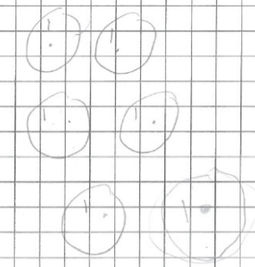

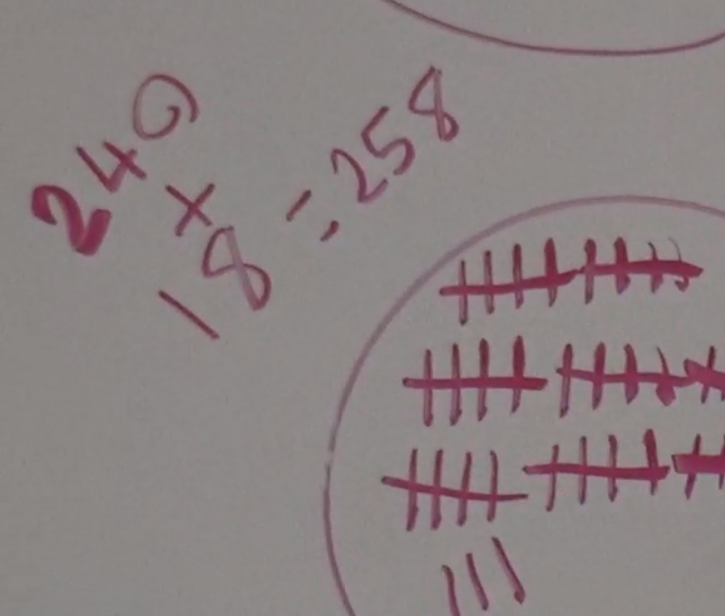
Discussing solution methods
“What do you think made the problem trickier?” A good way to begin the discussion.
To elicit the idea underlying efficiency (easy/fast) is important. In their worksheets, many children were using “groups of” strategy and “addition” (both repeated addition and split addition). For the children, important ideas will be “groupitize” and “split original number into easier numbers.” Another is “use multiplication” rather than writing and adding the same number six times.
Possibility of further teaching actions to enhance comparison/discussion of multiple solutions → e.g., connecting representations; finding common ideas; probing the name for a solution; utilizing Bansho (blackboard writing)
Dealing with “groups of”:
Elise “That’s just the fives. And, then I added the threes in a new group of 18…” Possibility to attend to the important idea of splitting and connect it with other solutions.
Notes:
A nice comment made by Alana to Jack’s strategy: “He’s using the split strategy, then he’s using the knowledge he already knew and he split them through knowledge…”
T: “so they’ve both splitted, but how re they a bit different? What’s the operation? How is it different?”
T: “Jack’s used addition and skip counting, whereas Ryan’s using, like Seine said, his knowledge of multiplication strategy.” The teacher’s blackboard writing: ‘split multiplication strategy’

Slide 7
Highlighting and summarizing the major points
The children wrote “handy hint” for someone to solve this problem. Four children presented their hints. Nice opportunity.
They also could solve similar problem by themselves to reflect on the solutions. Not just listening to solutions by others but also doing by themselves fosters learning. It is also important to make connection to the next lesson.
Opportunity for critical reflection of the lesson by the children’s writing of “handy hints”:
The number of children who wrote about the idea of splitting was small.
Several children wrote that “groups of” strategy is not efficient so should not be used.
What do you want to do in the next lesson? What questions do you have now?
Notes:
The reflection of the lesson (the process of problem solving) is important. But it often happens that few minutes are left.
Ari’s had the opportunity to express his idea.
“back up strategy” “double check”: important

Slide 8
Summary
As I showed in the slides, I observed important teaching actions to elicit children’s thinking, making connections as well as reflections. The teacher is calm and carefully listens and gives feedback to the variety of children’s voices. I was also impressed by the children from different grade levels who work together and learn from each other.
Since this is “composite class,” setting up a common lesson-goal as well as organizing the whole-class discussion toward the goal is not easy. One attempt would be to connect and emphasize the ideas underlying efficiency to enhance each child’s internalization.
I wonder what the differences are between the inquiry approach emphasized in Australia and the structured problem solving approach to teach mathematics in Japan.

Slide 9
Thank you

