Slide 1

Lesson Study at South Geelong Primary School

Slide 2
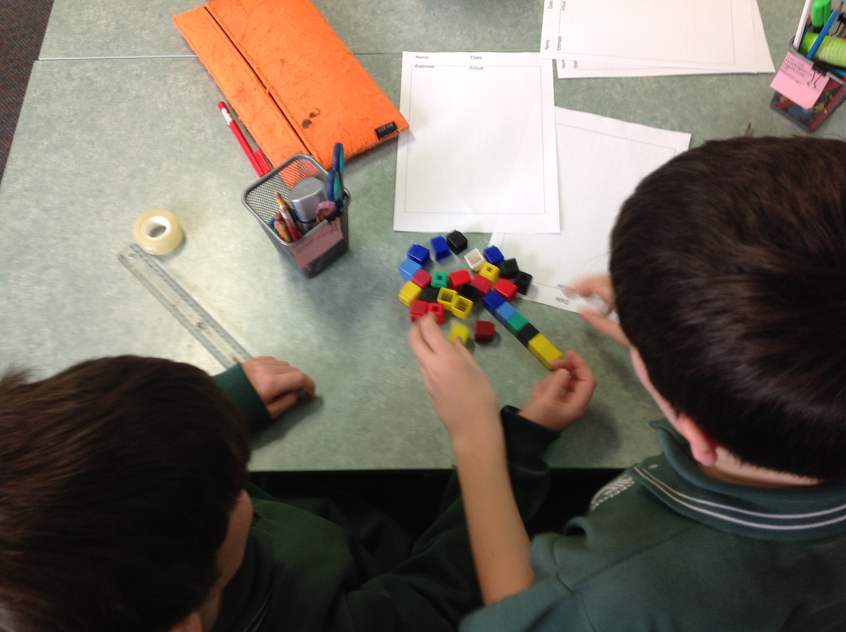
2014
The first lesson study was conducted at South Geelong Primary School.
This lesson study was conducted within the Year 3/4 Professional Learning Team.
All understandings of lesson study were based on the research conducted by the teachers within this Professional Learning Team.

Slide 3
2015
A Knowledgeable Other was first included in lesson study.
The feedback and discussion points given by the Knowledgeable Other were integral to the change and development of lesson study at South Geelong Primary School.
All teaching staff were introduced to lesson study through professional development.

Slide 4
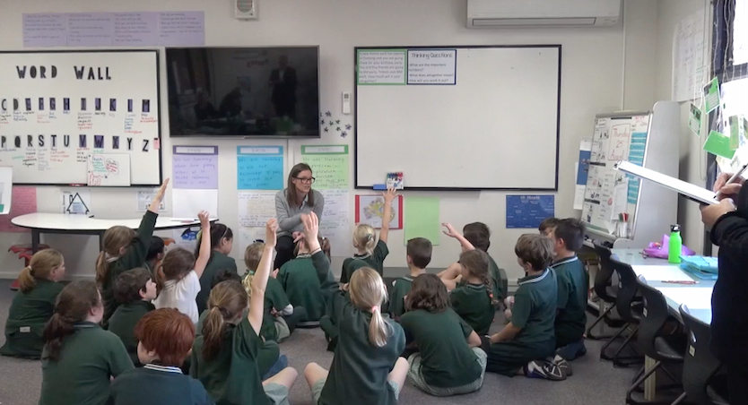
2016
I attended Project IMPULS in Japan.
Lesson study was implemented as a whole school approach.
There was continued involvement and support from Deakin University including a Knowledgeable Other.
Continued professional development was conducted for all teaching staff at South Geelong Primary School.

Slide 5
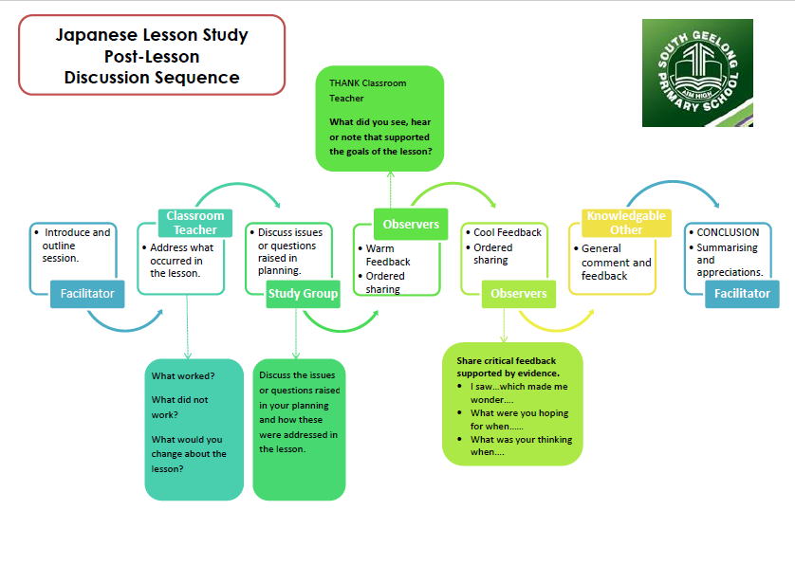
2017 - 2020
Lesson study protocols and procedures were developed in 2017.
Lesson study was conducted with all classroom teaching staff and school leadership in 2017.
Continued professional development was conducted with all teaching staff in 2017.
A lesson study was conducted within the Foundation Professional Learning Community in 2019.

Slide 6
